Slide 1
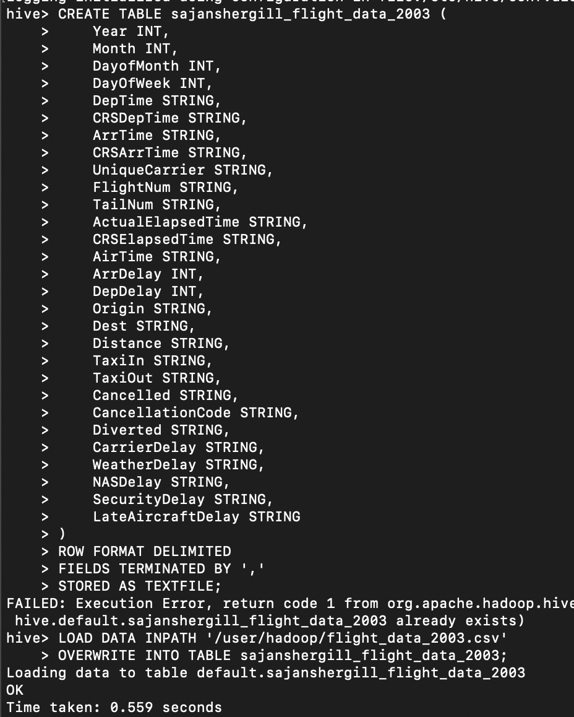
1) Create a new table in Hive with the format of your year table. Name it “sample” with your name (yourname_sample)

Slide 2
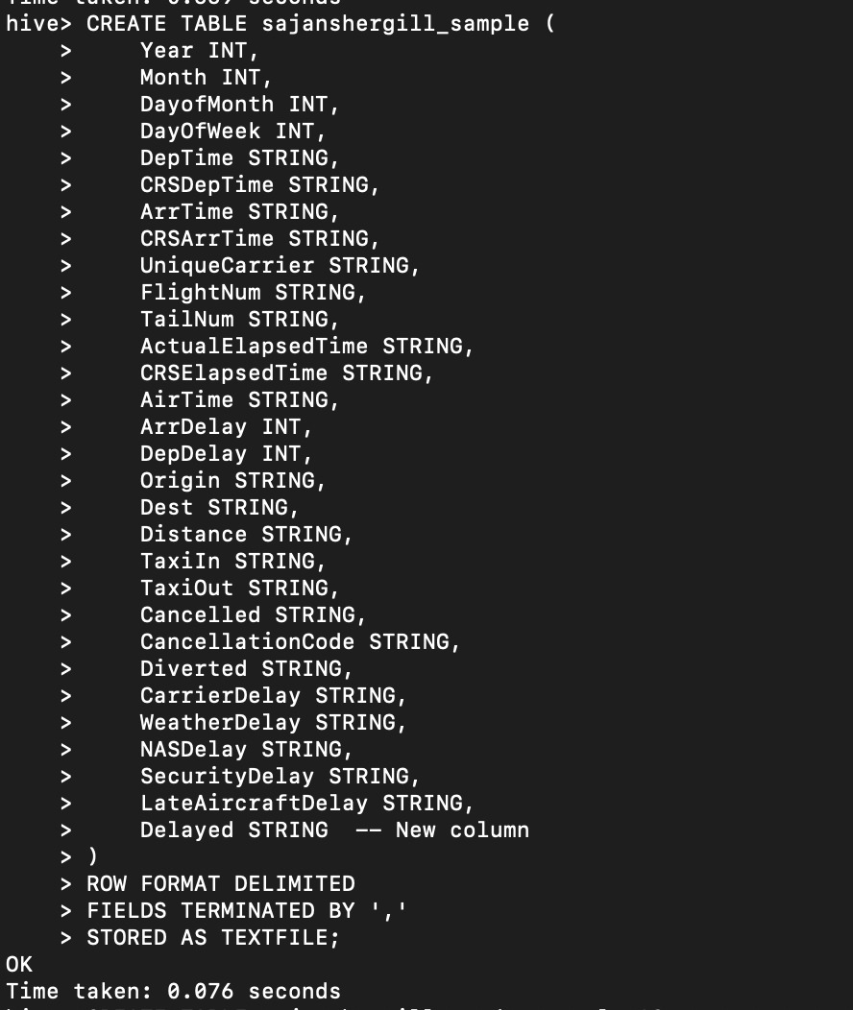
2) Add a new column to the yourname_sample table and label it Delayed

Slide 3
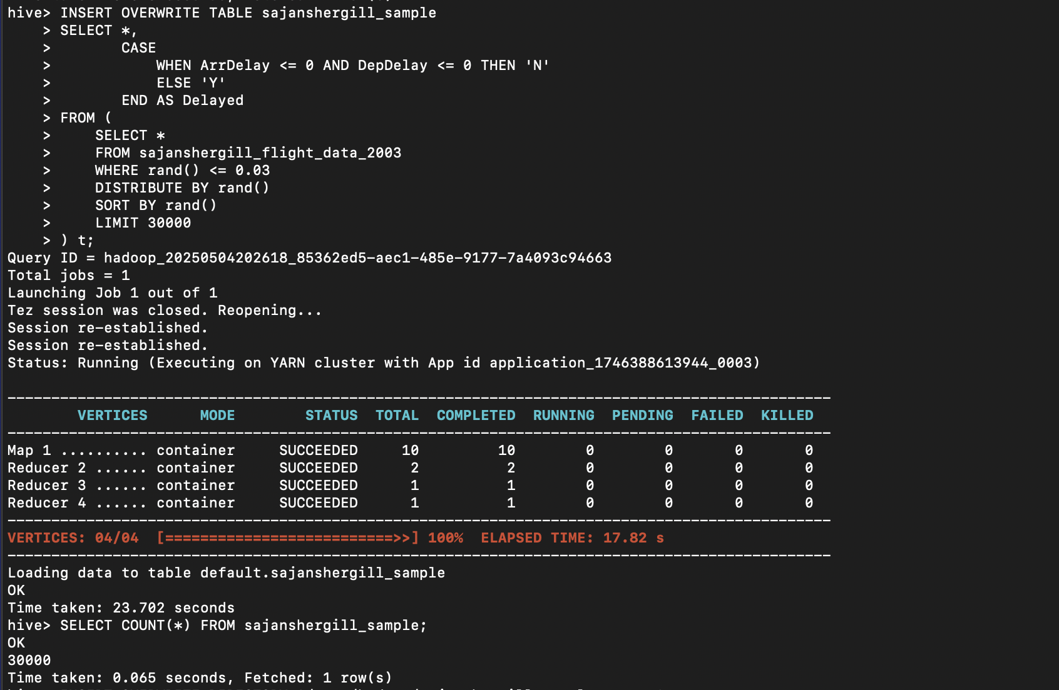
3) Select a random sample of 30,000 records from all across your year table.
4) Load your 30,000 sample records into this table and check that all the records are loaded

Slide 4
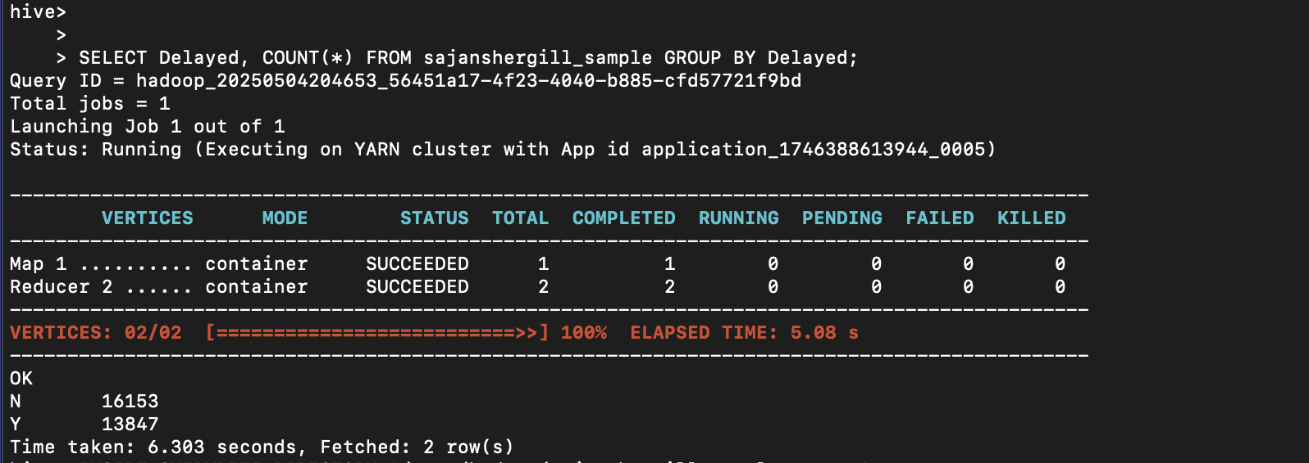
5) Populate the Delayed column as follows a. if the record has a value of zero or less in the ArrDelay and DepDelay columns, put a “N” in the Delayed column b. otherwise, put a “Y” in the Delayed column

Slide 5
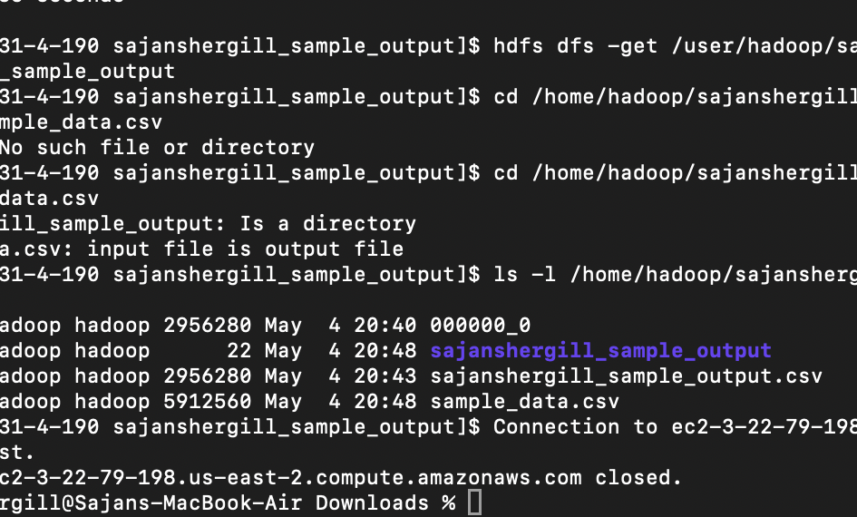
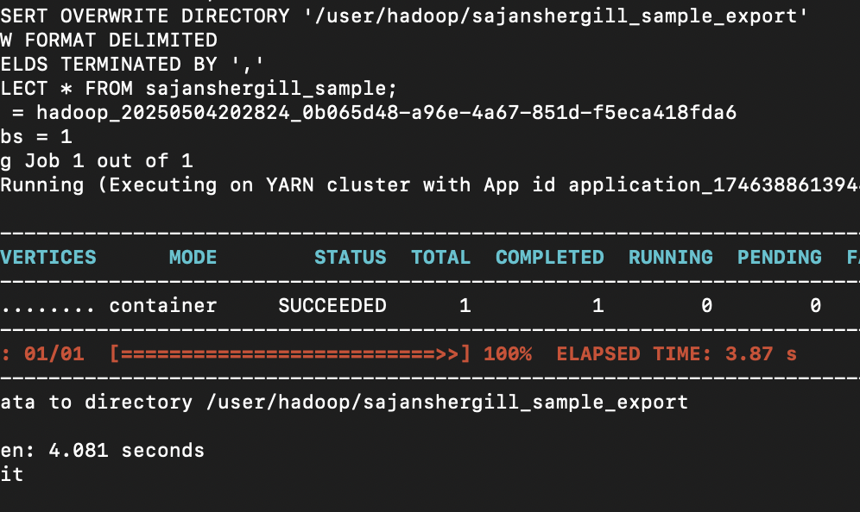
6) Extract your 30,000 sample records from Hive and download it to your local device

Slide 6
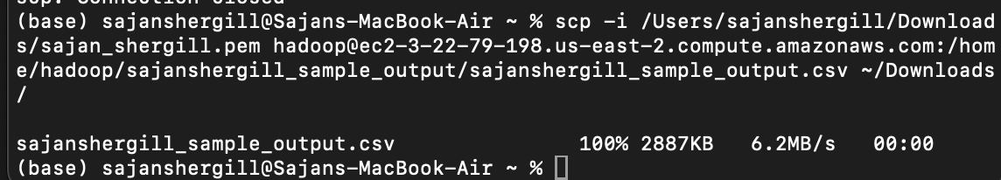
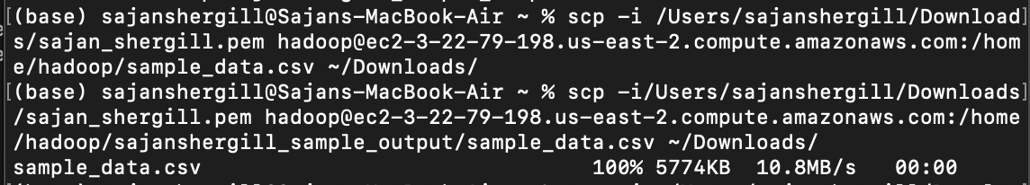

Slide 7
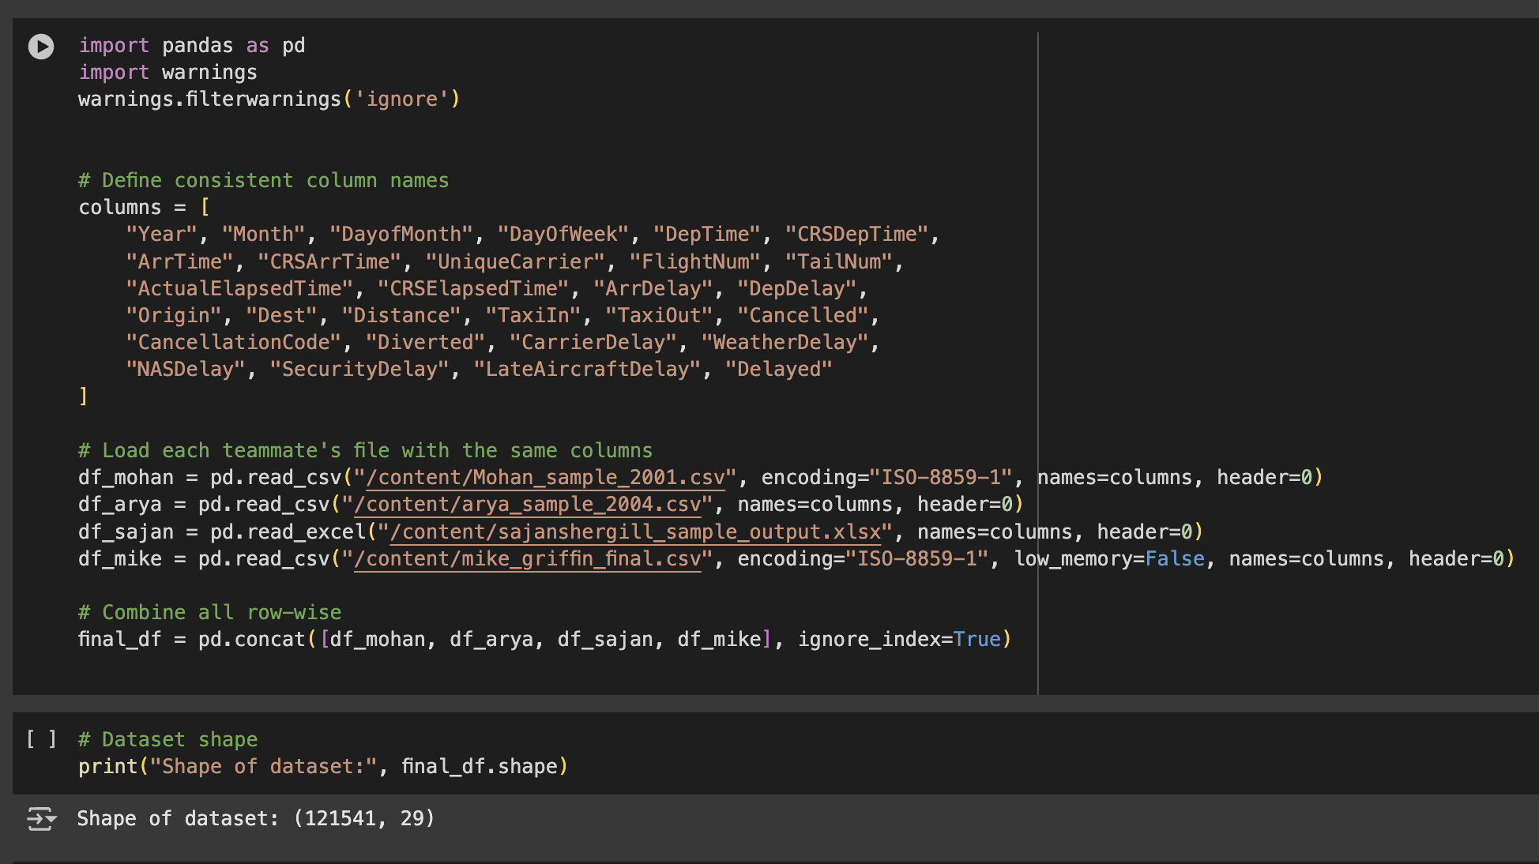
7) Combine your file with the other sample year files from your other team members. (120,000/150,000 depends on amount of group members records in total)

Slide 8
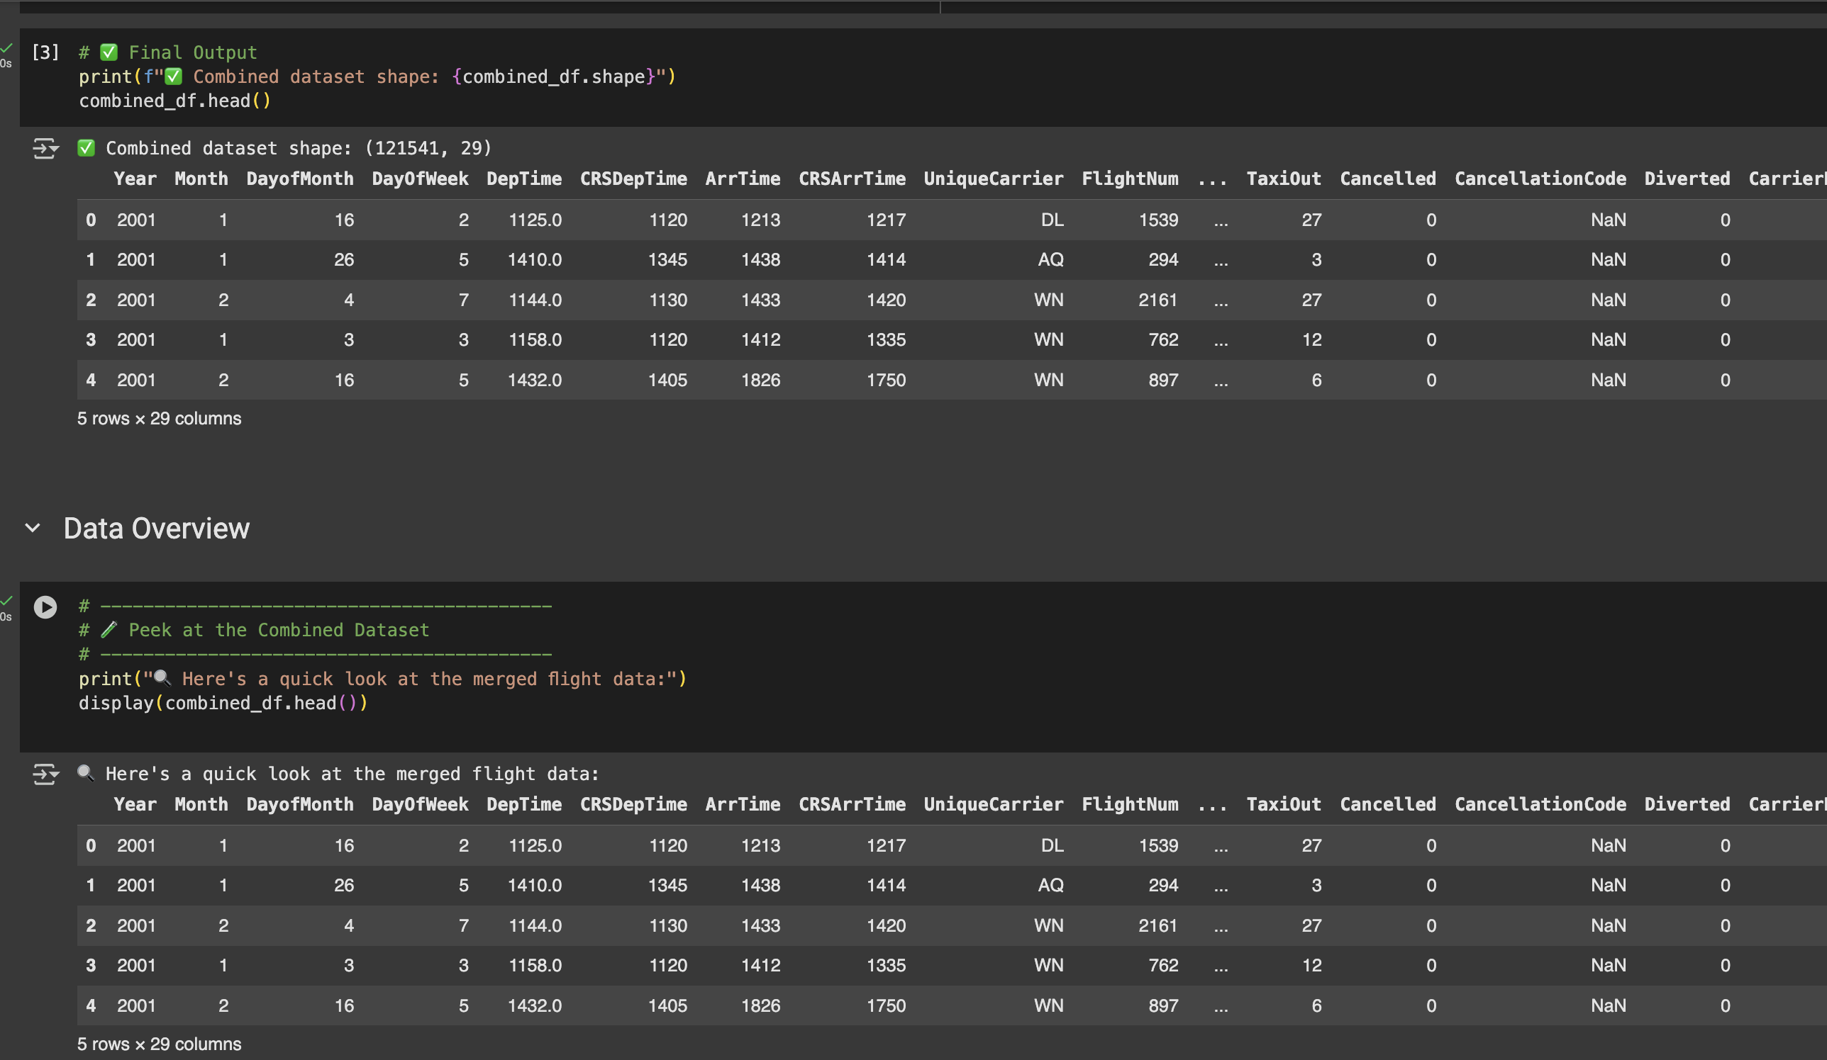
dATA overview

Slide 9
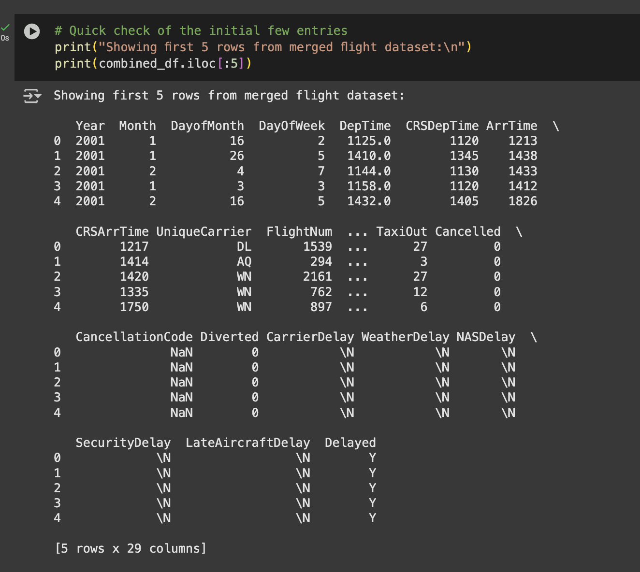
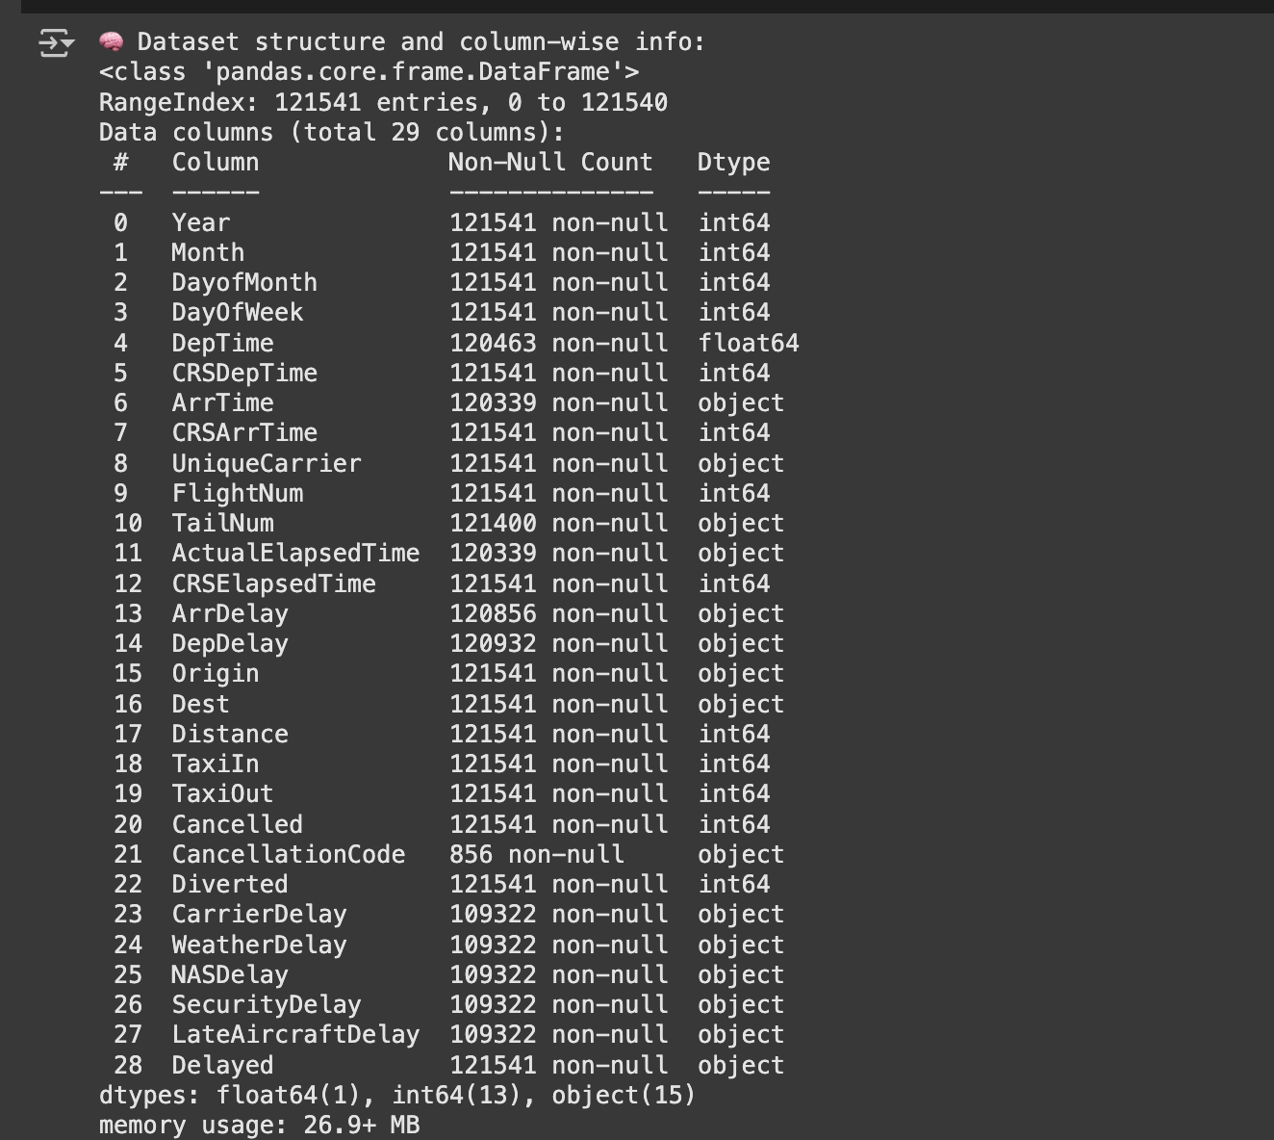
DATA OVERVIEW

Slide 10
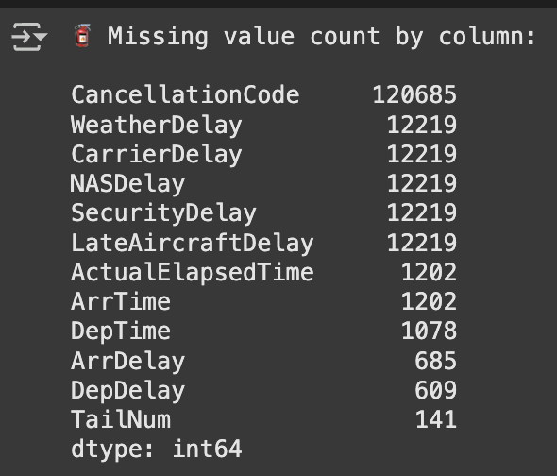
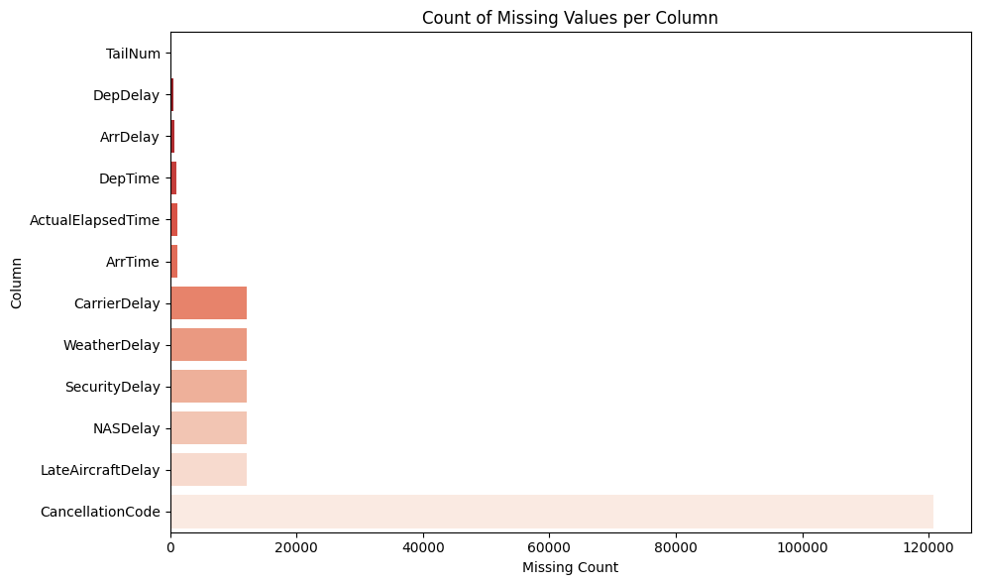
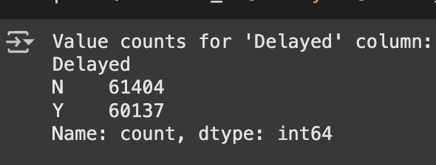
tARGET VALUE COUNT AND CHECKING MISSING VALUES

Slide 11
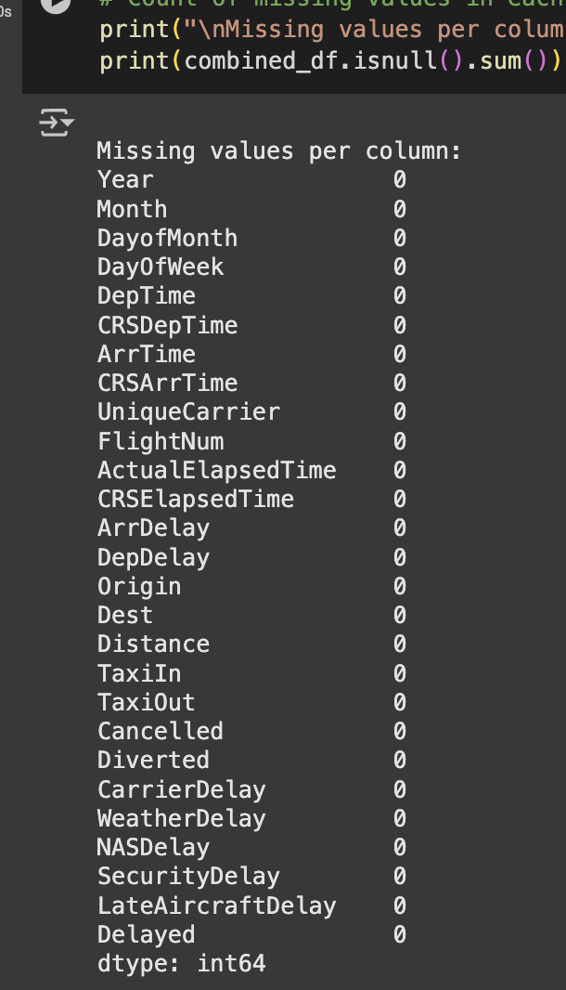
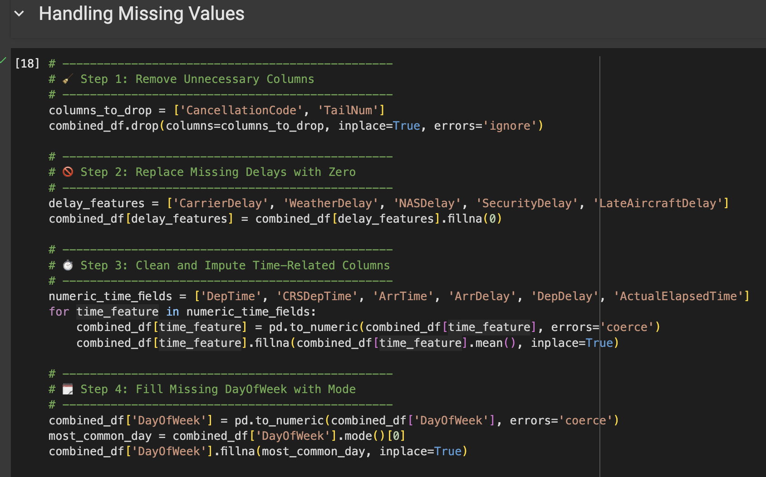
Handling the Missing Values
Removing columns that don’t add predictive value (like TailNum, which is just an aircraft ID, and CancellationCode, which is mostly null).
When a delay reason was missing, I assumed no delay occurred and filled those nulls with 0.
Converted all timing-related columns to numeric and filled any missing values with their column mean.
For DayOfWeek, I used the most frequent day (mode) to fill missing values. It made more sense for categorical info like this.

Slide 12
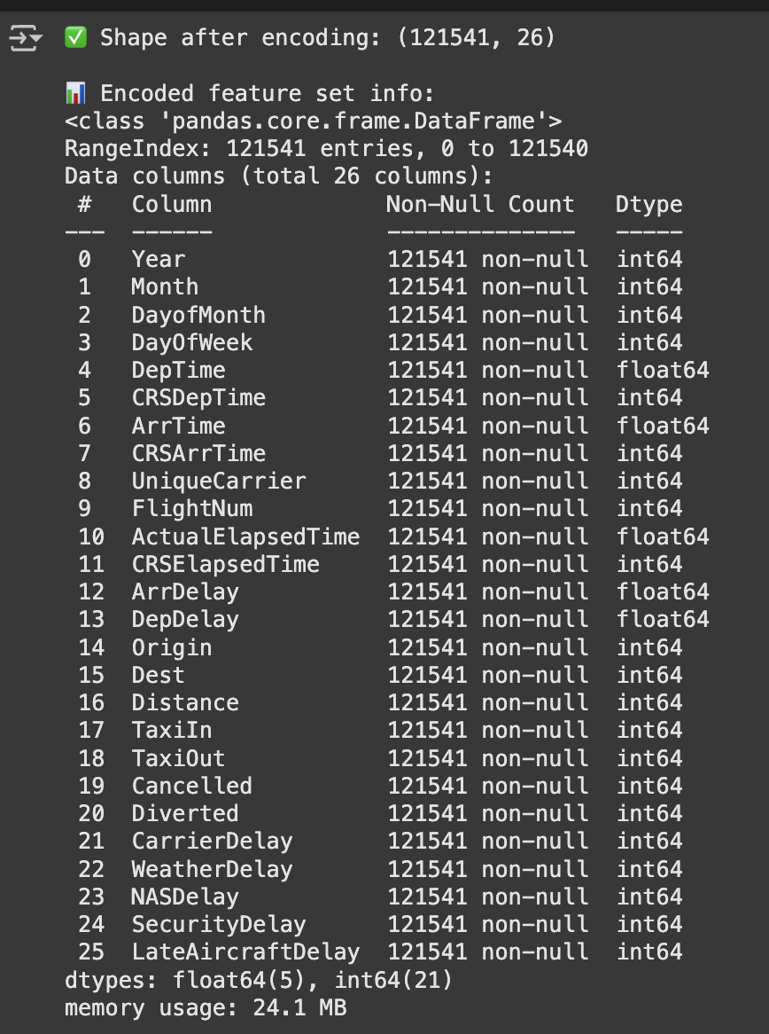
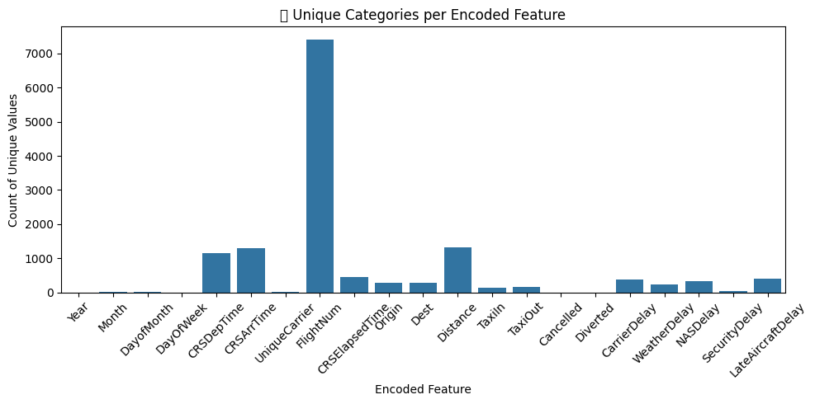
Label Encoding

Slide 13
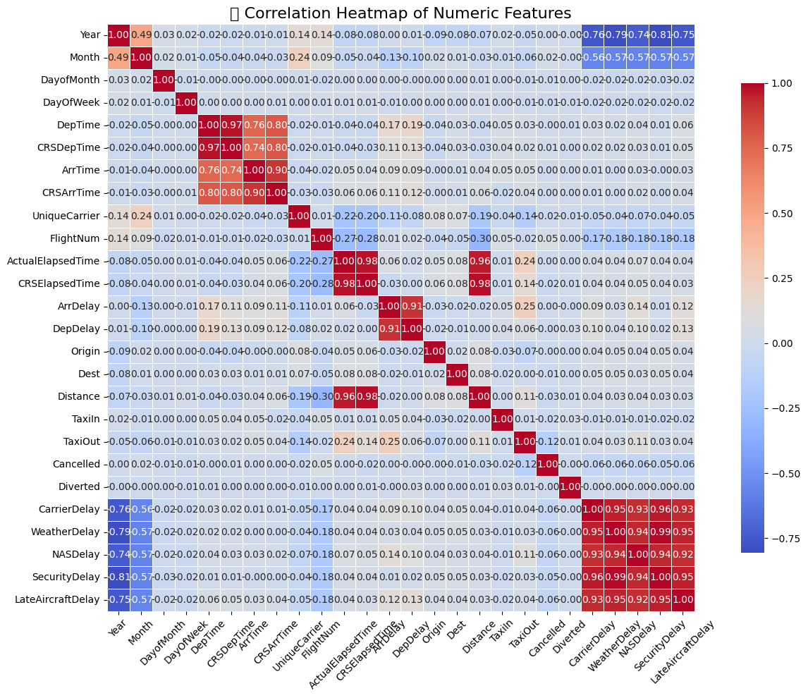
Correlation Heatmap
DepDelay and ArrDelay have a very strong correlation (~0.9), which is expected — flights that depart late generally arrive late as well.
CRSDepTime and CRSArrTime also show high correlation (~0.8), indicating that scheduled departure and arrival times are closely planned together.
CRSElapsedTime and Distance have an extremely strong correlation (~0.96), meaning longer distances naturally lead to longer scheduled durations — including both may be redundant.
Features like Year, Month, DayOfWeek, Origin, and Dest show very low correlation, suggesting they don’t have a strong linear relationship but may still be useful for non-linear models.

Slide 14
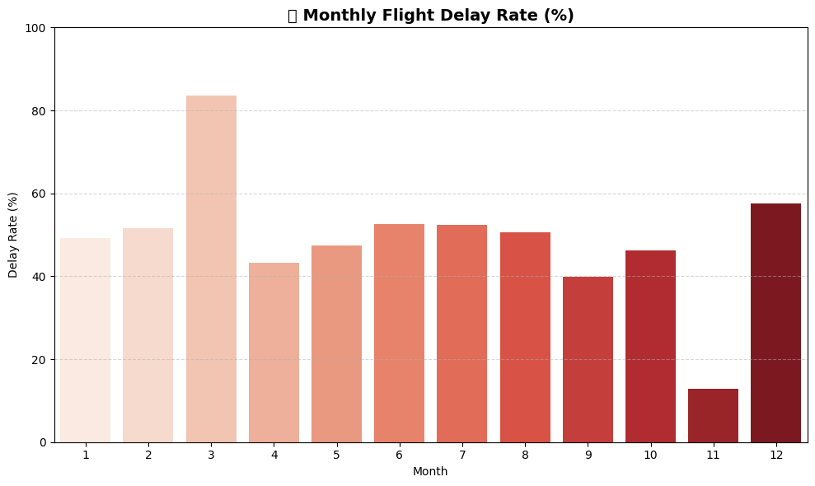
Monthly Flight Delay Trend
March (Month 3) shows the highest delay rate (~85%), indicating a significant spike — possibly due to seasonal transitions or operational bottlenecks.
November (Month 11) has the lowest delay rate (~15%), suggesting it was the most reliable month for on-time flights.
Most months between May and October maintain moderate delay rates (~45–55%), reflecting stable operations with no extreme disruptions.
January, February, and December show above-average delays, likely influenced by winter weather and holiday travel congestion.

Slide 15
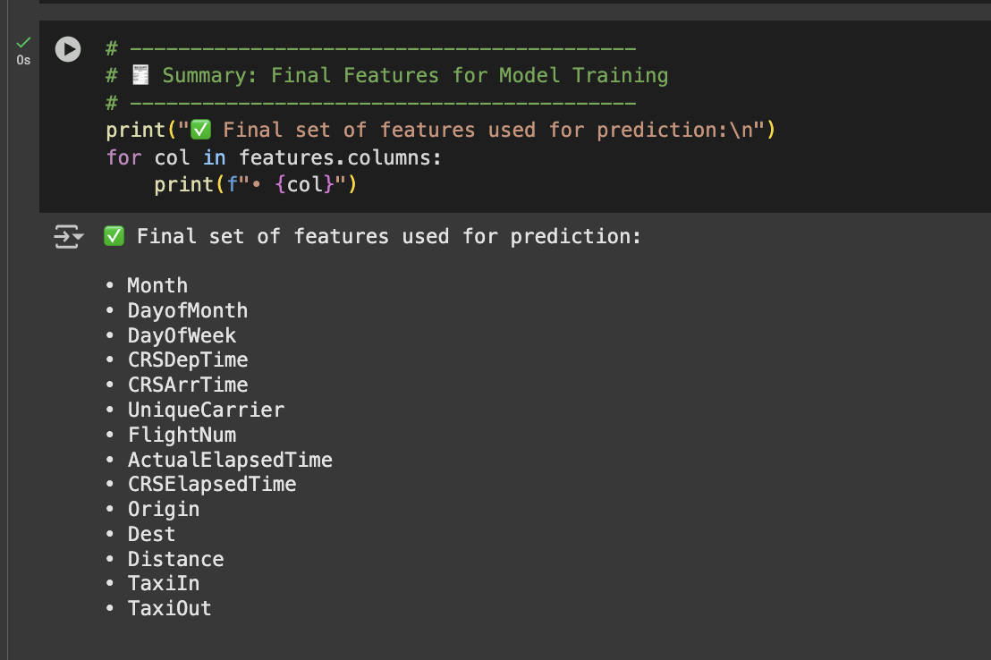
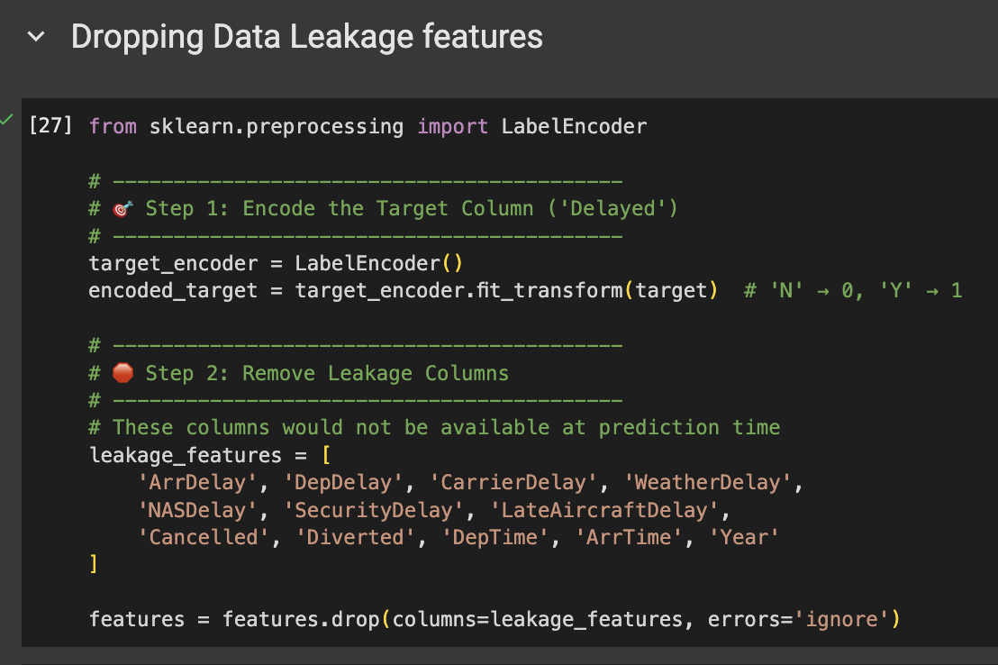
Feature Engineering and Dropping Data Leakage features

Slide 16
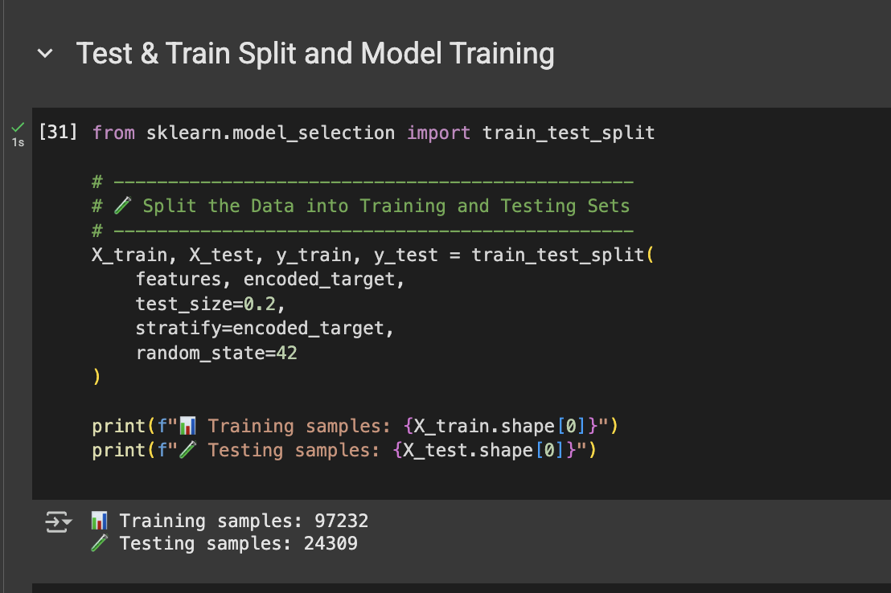
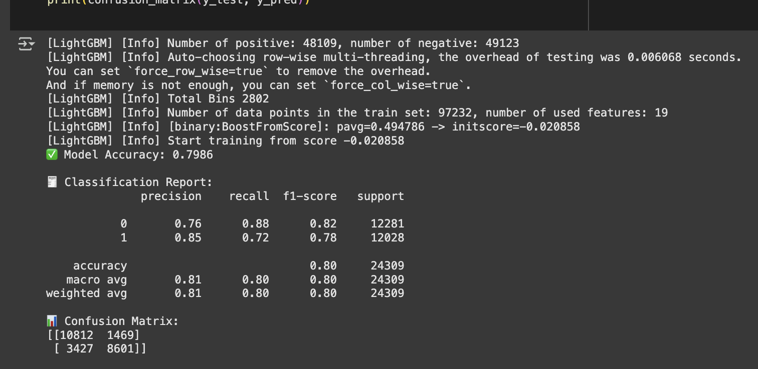
STEP-7 Train, validate and test the analytics model with the team’s combined sample data
Data Split with Stratification used train_test_split with stratify=y to maintain the original class balance of the 'Delayed' column in both training and test sets — ensuring fair and unbiased model evaluation.
Model Selection – LIGHTGBM Chose LGBMClassifier for its speed, ability to handle large datasets, and native support for categorical features. Trained the model on our engineered feature set with binary_logloss as the evaluation metric to accurately classify flight delays.

Slide 17
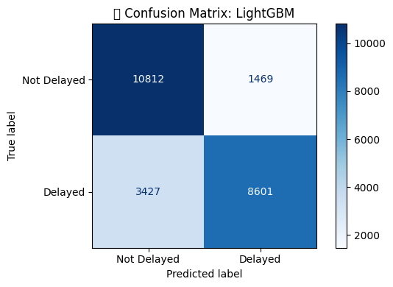
Confusion Matrix
Top-left (5,007): Flights correctly predicted as Not Delayed (True Negatives)
Bottom-right (4,105): Flights correctly predicted as Delayed (True Positives)
The model demonstrates strong performance in distinguishing between delayed and non-delayed flights, with relatively low misclassification.
Precision (Delayed = 1): 0.91 → Of all flights predicted as delayed, 91% were actually delayed
Recall (Delayed = 1): 0.88 → The model correctly identified 88% of actual delayed flights
F1-Score: 0.89 → Indicates a balanced trade-off between precision and recall
Accuracy: 90.1% → Overall, 90% of all flight predictions were correct

Slide 18
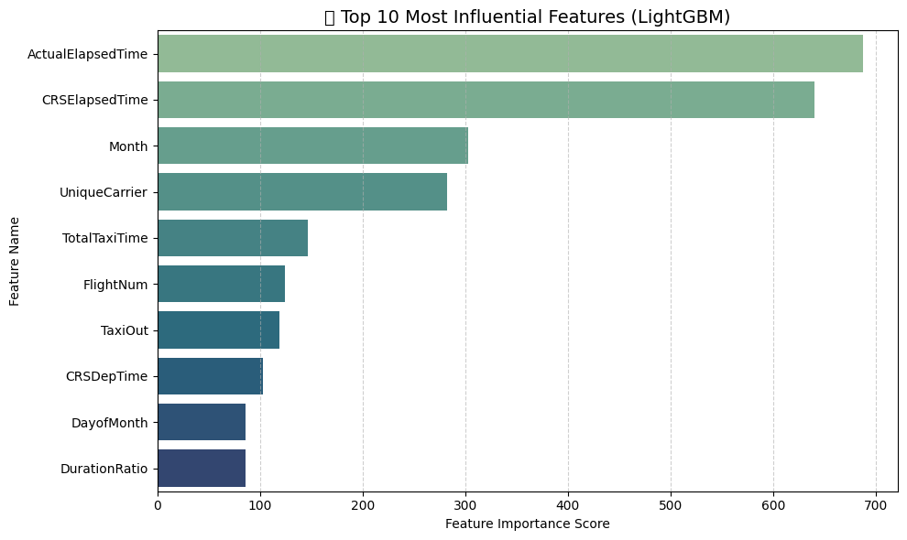
FEATURE IMPORTANCE

Slide 19
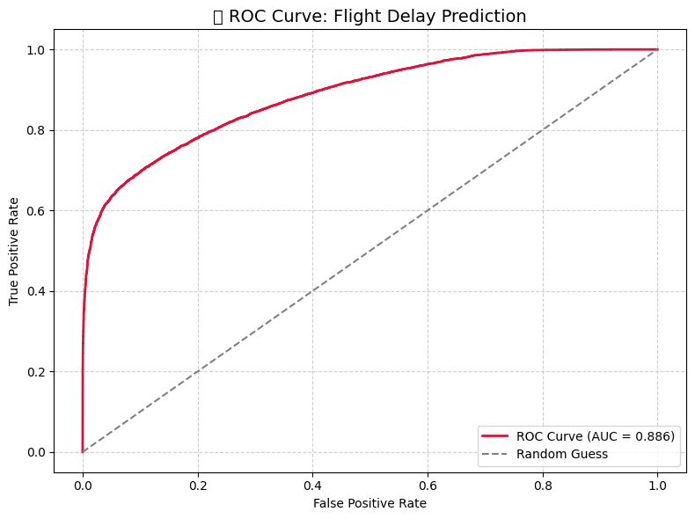
ROC and AUC Curve
The ROC curve evaluates the model's ability to distinguish between delayed and non-delayed flights across different thresholds.
The red curve rises well above the diagonal (random guess line), indicating strong classification performance.
AUC Score: 0.886 → The model has an 88.6% chance of correctly ranking a randomly chosen delayed flight higher than a non-delayed one.
True Positive Rate (Y-axis): Shows how well the model detects actual delays (Recall).
False Positive Rate (X-axis): Shows how often the model incorrectly labels non-delayed flights as delayed.
Since the curve stays far above the diagonal, the model performs significantly better than random guessing and is effective in separating the two classes.

Slide 20
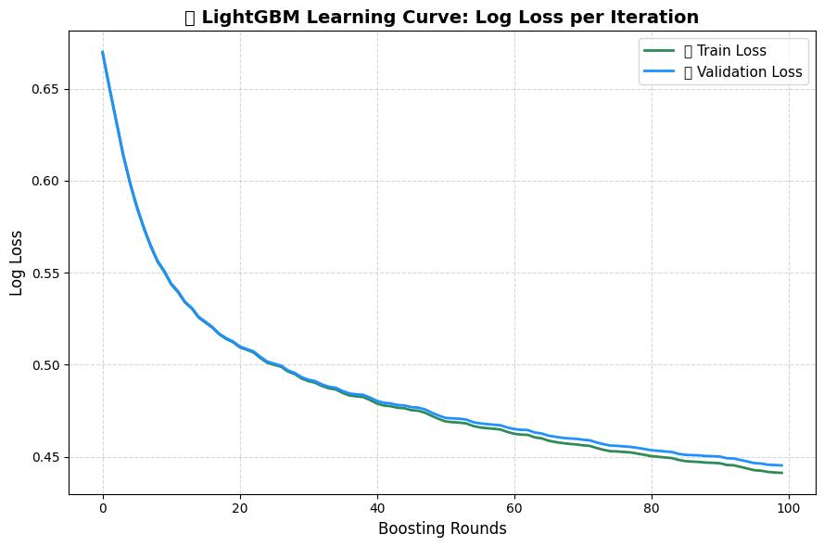
Learning curve
The learning curve shows how log loss decreases over boosting rounds for both training and validation sets.
Both curves drop steadily, indicating consistent learning without overfitting.
Train Loss and Validation Loss closely follow each other, suggesting that the model generalizes well to unseen data.
Log Loss decreases from ~0.67 to ~0.44 across 100 iterations, meaning the model becomes increasingly confident and accurate in its predictions.
The absence of divergence between the two curves confirms the model is well-tuned and not overfitting, which strengthens its reliability on test data.

Slide 21
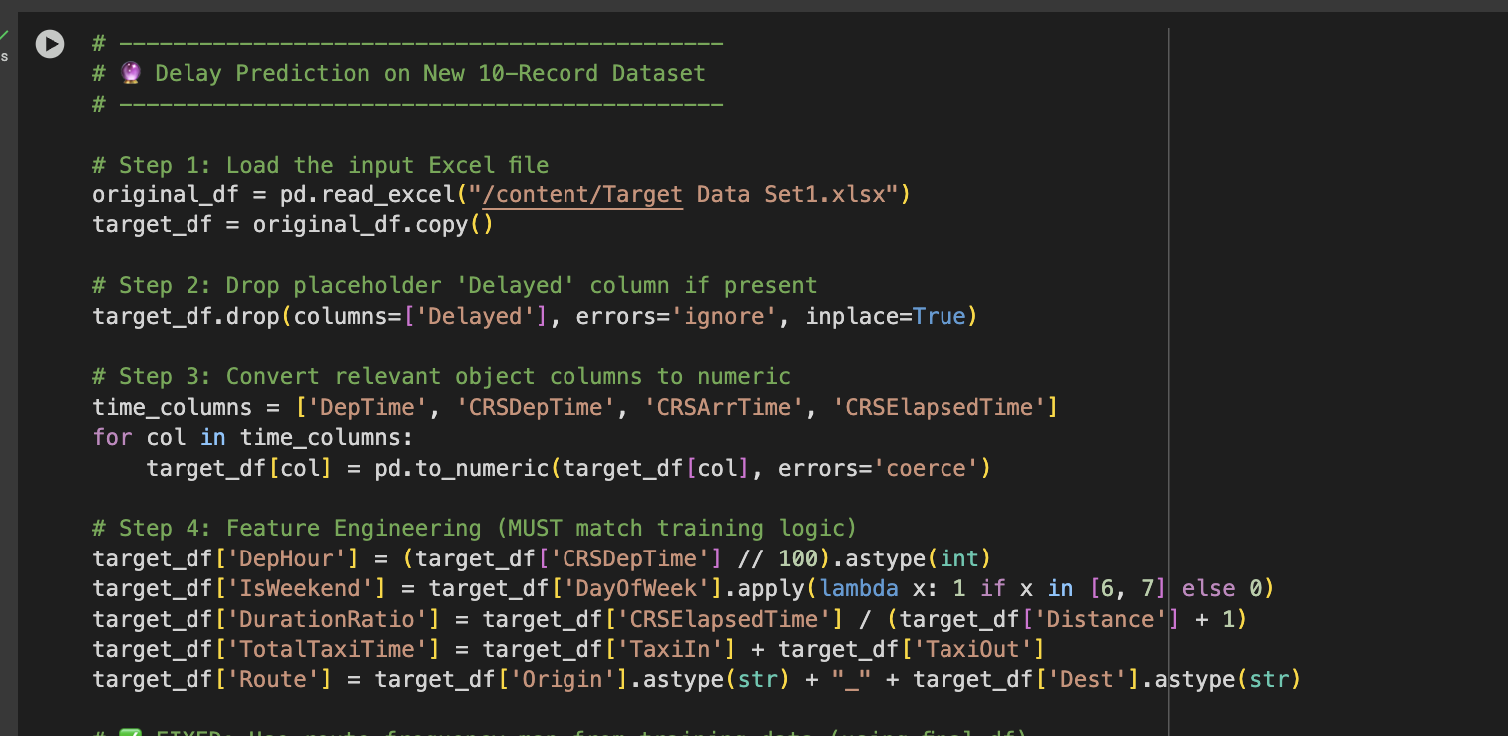
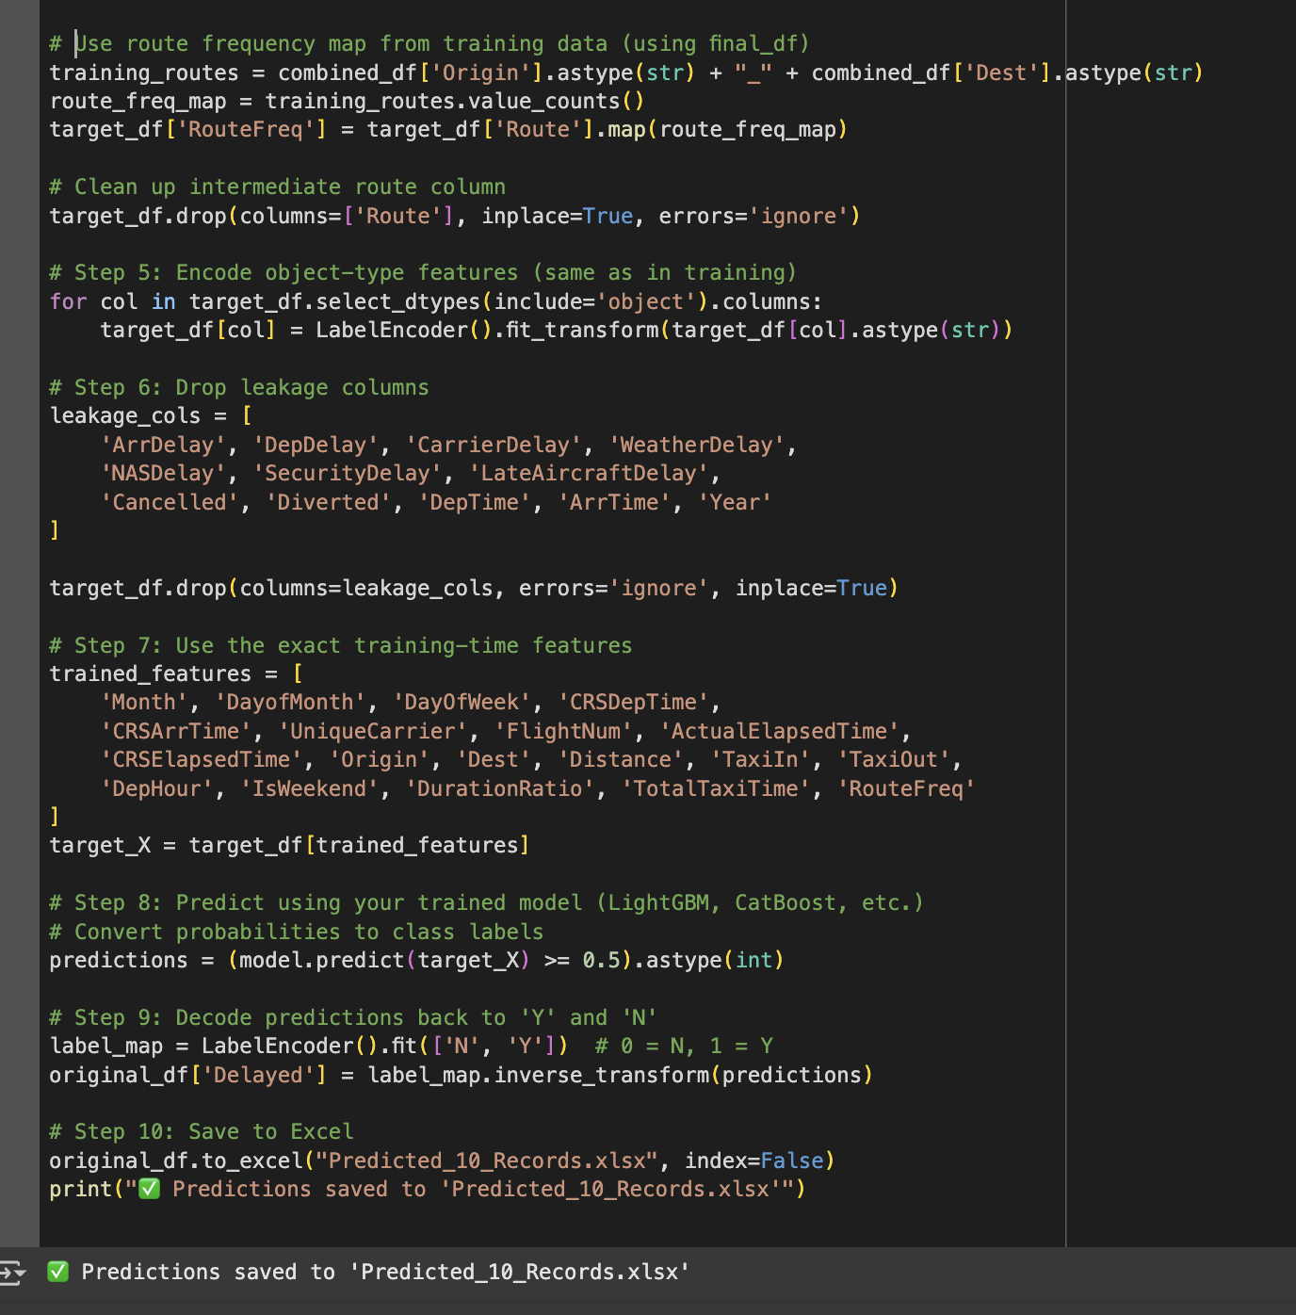
Using the model chosen by the team, each member will work with ‘ten records’ provided by the instructor to determine whether a flight is delayed or not and score it with a Y or N accordingly. (See example below)

Slide 22
